Slide 1
SLU MEDICAL SCHOOL AND CLYDE C. MILLER CAREER ACADEMY PARTNERSHIP
Partnering to create opportunities to increase scientific knowledge and provide hands-on lessons in the lab
Dissected fetal pigs
Helped review and prepare for Biology EOC state exam
Discussed experiences in school and life that led to medical school

Slide 2
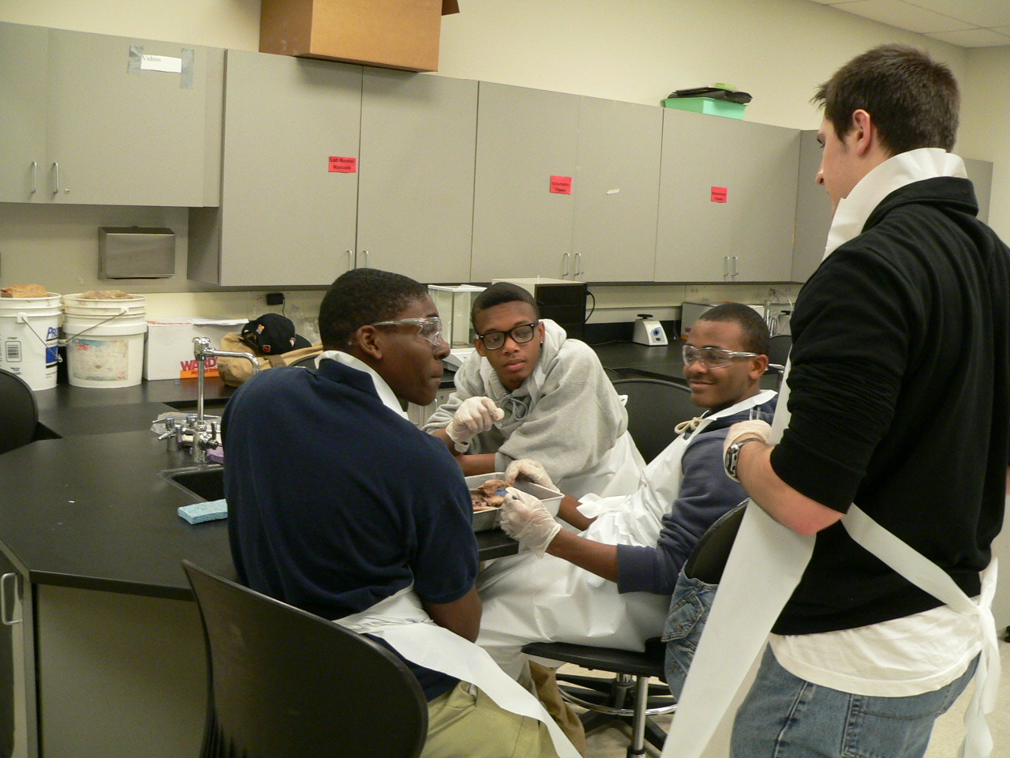

Slide 4
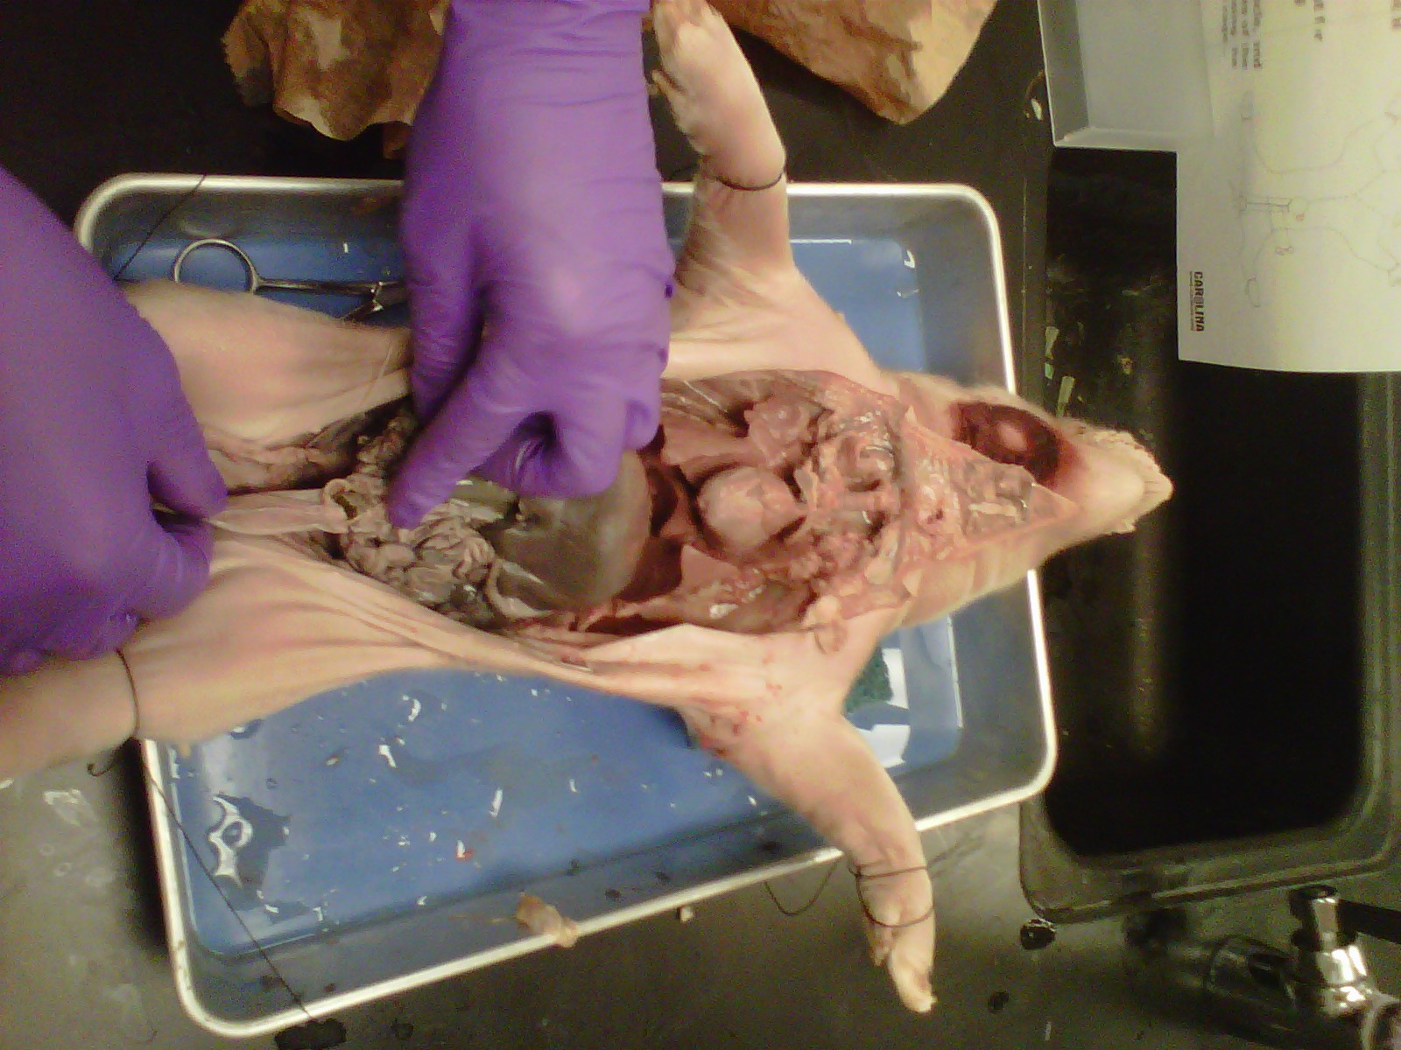

Slide 5
